Slide 1
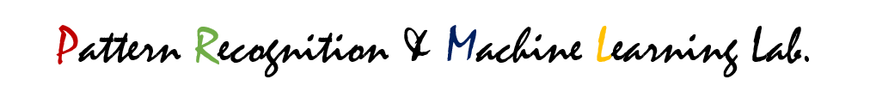

ProLLaMA: A Protein Language Model for Multi-Task Protein Language Processing
Lv, Liuzhenghao; Lin, Zongying; Li, Hao; Liu, Yuyang; Cui, Jiaxi; Yu-Chian Chen, Calvin; Yuan, Li; Tian, Yonghong
Peking University, China Peng Cheng Laboratory
Presented By: Sung-Yoon Ahn

Slide 2
Abstract
Large Language Models (LLMs) have achieved remarkable performance in multiple Natural Language Processing (NLP) tasks. Under the premise that protein sequences constitute the protein language, Protein Language Models(PLMs) have advanced the field of protein engineering. However, as of now, unlike LLMs in NLP, PLMs cannot handle the protein understanding task and the protein generation task simultaneously in the Protein Language Processing (PLP) field. This prompts us to delineate the inherent limitations in current PLMs: (i) the lack of natural language capabilities, (ii) insufficient instruction understanding, and (iii) high training resource demands. To address these challenges, we introduce a training framework to transform any general LLM into a PLM capable of handling multiple PLP tasks. To improve training efficiency, we propose Protein Vocabulary Pruning (PVP) for general LLMs. We construct a multi-task instruction dataset containing 13 million samples with superfamily information, facilitating better modeling of protein sequence-function landscapes. Through these methods, we develop the ProLLaMA model, the first known PLM to handle multiple PLP tasks simultaneously. Experiments show that ProLLaMA achieves state-of-the-art results in the unconditional protein sequence generation task. In the controllable protein sequence generation task, ProLLaMA can design novel proteins with desired functionalities. As for the protein understanding task, ProLLaMA achieves a 62% exact match rate in superfamily prediction.

Slide 3
Abstract
Problems of current PLM’s
the lack of natural language capabilities
insufficient instruction understanding
high training resource demands
Propose
a training framework to transform any general LLM into a PLM capable of handling multiple PLP tasks
Protein language pruning for efficiency
Create multi-task instruction dataset

Slide 4
Introduction
Large Language Models (LLMs), like GPT-x and LLaMA2 [1, 2], have achieved outstanding performance in handling a wide range of Natural Language Processing (NLP) tasks [3–9], including both Natural Language Generation (NLG) and Natural Language Understanding (NLU) tasks, in a generative manner. This surge in LLMs has extended their applications beyond traditional contexts, including their adoption in the challenging field of protein engineering [10–14].
Taking protein sequences as the protein language, researchers train Protein Language Models (PLMs) on vast protein corpora [6, 11, 12]. PLMs have the potential to significantly advance protein engineering, holding immense promise for biomedical and biotechnological innovations [10]. However, this progress is challenged, particularly in extending their capabilities to multi-task Protein Language Processing (PLP).
Analogous to NLP, tasks related to protein language can be viewed as PLP [15, 16]. Consequently, PLP tasks can also be divided into two categories: Protein Language Generation (PLG), such as protein sequence generation, and Protein Language Understanding (PLU), such as protein property prediction. However, current PLMs tend to focus either exclusively on PLG [17–19] or PLU [20–24], rather than being proficient in both aspects simultaneously, as LLMs in NLP.

Slide 5
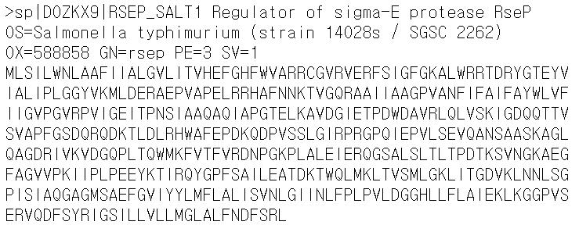
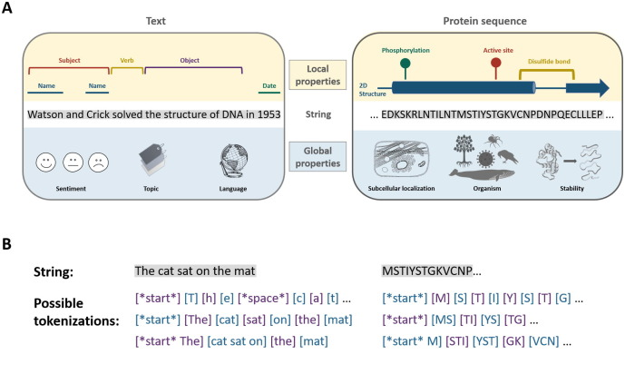
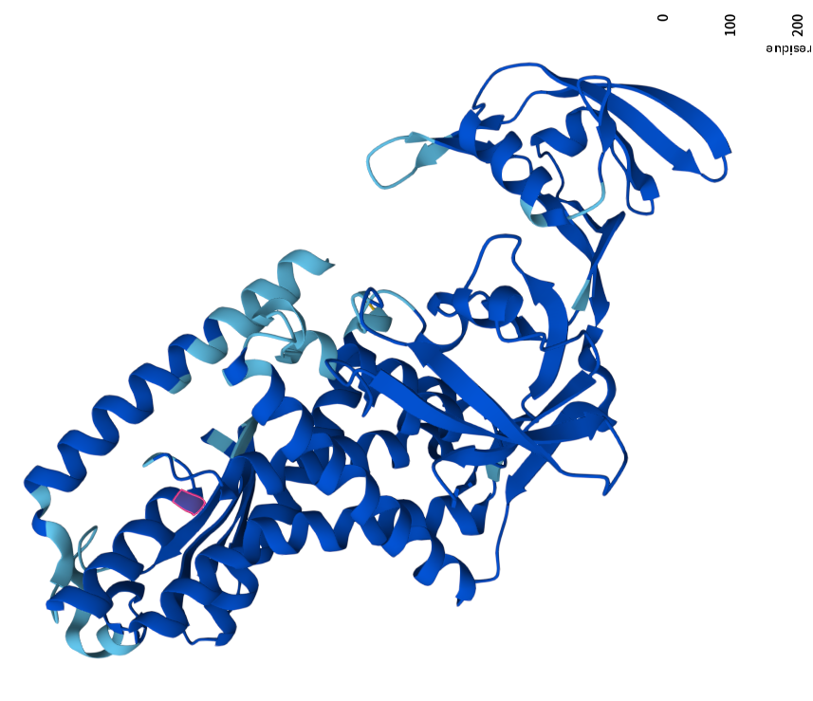
Introduction
Ofer, Dan, Nadav Brandes, and Michal Linial. "The language of proteins: NLP, machine learning & protein sequences." Computational and Structural Biotechnology Journal 19 (2021): 1750-1758.

Slide 6
Introduction
These limitations prompt the need for innovative solutions to unleash the full potential of PLMs. Developing a multi-task PLM would be highly beneficial for protein engineering and protein fitness landscape modeling [25–28], but three main challenges must be considered:
Necessity of Natural Language: Protein language is not fully sufficient for PLP tasks, meaning it cannot fully represent all components of a task (the task instruction, the input, and the expected output) [29, 30]. It requires a language beyond protein language (typically, natural language) for representation, which current PLMs lack.
Instruction Following: To possess multi-task capabilities, models must execute tasks following user instructions [31–33]. However, current PLMs are unable to follow instructions.
Training Resource Consumption: Substantial training resources are needed for models to learn natural language, protein language, and user instructions [34], which can sometimes be unaffordable.

Slide 7
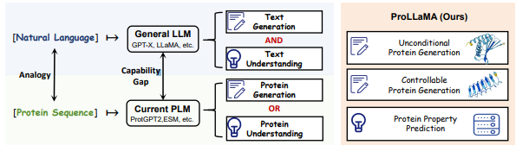
Introduction
Figure 1: Left: LLMs can handle both generation and understanding tasks, whereas PLMs cannot. This highlights the disparity in capabilities between the two. Right: Our ProLLaMA can handle generation tasks (unconditional protein generation, controllable protein generation) and understanding tasks (protein superfamily prediction), surpassing current PLMs.

Slide 8
Introduction
To address the challenges, we construct an instruction dataset that contains approximately 13 million samples and encompasses both PLG and PLU tasks. We propose a two-stage training framework to achieve a PLM for multi-task PLP. In the first stage, we leverage a pre-trained general LLM like LLaMA2 to continually learn the protein language while maintaining the natural language knowledge. In the second stage, the model is further trained on the multi-task instruction dataset. Additionally, we propose Protein Vocabulary Pruning (PVP) for general LLMs to significantly improve training efficiency. Furthermore, during both stages, we adopt Low-Rank Adaptation (LoRA) [35], which prevents catastrophic forgetting in the first stage and reduces training costs in both stages.

Slide 9
Introduction
Using these methods, we develop ProLLaMA, a model capable of multi-tasks for PLP, distinguishing it from all other PLMs. Through a series of experiments, we demonstrate the multi-task capabilities of our ProLLaMA. Specifically, as for PLG, in unconditional protein generation, ProLLaMA outperforms current PLMs on common metrics such as pLDDT and TM-score. In controllable protein generation, based on a user-provided textual description, ProLLaMA generates novel proteins from scratch with desired functionalities, such as the SAM-MT superfamily. As for PLU, in protein superfamily prediction, ProLLaMA achieved a 62% exact match rate on the test dataset and obtained an F1-score above 0.9 in many specific categories. In summary, the contributions of our research are as follows:
• We propose a training framework that enables any general LLM to be trained as a proficient model for multi-task PLP, including both PLG and PLU tasks.
• We propose Protein Vocabulary Pruning and are the first to apply Low-Rank Adaptation in the training of large PLMs, which improves the efficiency of protein learning.
• We construct an instruction dataset that contains 13 million samples and over 11,000 kinds of superfamily annotations, potentially facilitating a better modeling of sequence-function landscapes.
• Experiments show that our ProLLaMA not only handles multiple PLP tasks but also achieves state-of-the-art results in protein generation tasks.

Slide 10
Preliminaries
Necessity of Natural Language.
As aforementioned, given the similarities between protein sequences and natural language, tasks related to protein sequences can be considered as PLP, analogous to NLP. However, we observe a fundamental difference between protein language and natural language: natural language is complete for NLP tasks, whereas protein language is not complete for PLP tasks. For example, in the sentiment analysis task, instructions, inputs, and outputs are straightforwardly expressed in natural language, such as “Analyze the sentiment: I am happy” yielding “The sentiment is positive.” However, in PLP tasks like protein property prediction, instructions like “Predict this protein’s property: MAFCF...FEV” cannot be fully conveyed in protein language alone, necessitating assistance from a language beyond protein language, in this case, natural language, for representation. Therefore, multi-task PLMs must possess a certain level of natural language ability, especially as more textual descriptions of proteins become available [29].

Slide 11
Preliminaries
Low-Rank Adaptation (LoRA) [35]
is a parameter-efficient technique for fine-tuning LLMs. Due to the immense parameter size of LLMs, full-parameter fine-tuning could be impractical sometimes. LoRA circumvents this by freezing the original parameters of LLMs and introducing additional trainable low-rank adapters. It achieves fine-tuning with a significantly smaller number of trainable parameters, yielding results comparable to full-parameter fine-tuning. LoRA prevents catastrophic forgetting of the original knowledge, as the newly learned knowledge has a lower rank than the original knowledge. The theoretical details of LoRA are provided in Appendix A.2.

Slide 12
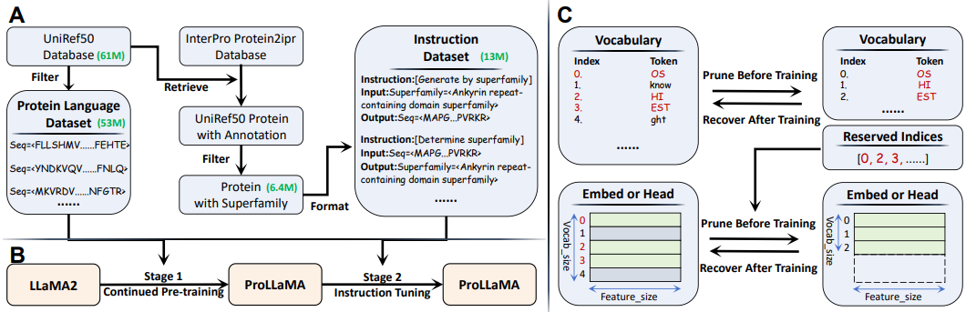
Methods
Figure 2: (A) Overview of the dataset construction. The protein language dataset contains 53 million samples, which is used for training in Stage 1. The instruction dataset contains 13 million instances with 11,268 unique superfamily annotations, which is used for training in Stage 2. (B) Overview of the training framework. Stage 1: The pre-trained LLaMA2 learns the protein language, resulting in ProLLaMA. Stage 2: ProLLaMA learns to perform multiple tasks by instruction tuning. (C) Overview of protein vocabulary pruning. The vocabulary, Embed layer and Head layer are pruned based on characteristics of protein datasets, aiming for higher training efficiency.

Slide 13
Method
In Section 3.1 and Figure 2(A), we show how to construct the protein language dataset and the instruction dataset. In Section 3.2 and Figure 2(C), we show how Protein Vocabulary Pruning (PVP) works. In Section 3.3, we show how the LLaMA2 model learns protein language on the protein language dataset through continued pre-training, resulting in ProLLaMA. In Section 3.4, we show the integration of various tasks into ProLLaMA through instruction tuning on the instruction dataset. The overview of the training framework is shown in Figure 2(B). The overview of the ProLLaMA model is shown in Figure 3.

Slide 14
Dataset Construction
The protein language dataset is utilized in the first training stage to enable LLaMA2 to grasp the language of proteins. Specifically, the dataset is sourced from UniRef50_2023_03 [36] on the UniProt website. We eliminate the descriptive parts of UniRef50, retaining only the pure protein sequences. Furthermore, We filter UniRef50 to ensure that the protein sequences consisted only of the 20 standard amino acids. We also retain sequences with a length of less than 512, aligning with ProGen [18]. Given that the lengths of protein sequences follow a long-tail distribution, the sequences that are deleted constitute only a small portion of the total dataset. To preprocess the protein sequences, we employ a specific prefix “Seq=”. This standardized format aids LLaMA2 in distinguishing the new protein language from its existing natural language knowledge, thereby reducing confusion. The original Uniref50 contains 60,952,894 sequences, while after the above series of processing, our dataset comprises 52,807,283 protein sequences, with 90% for training and 10% reserved for testing.

Slide 15
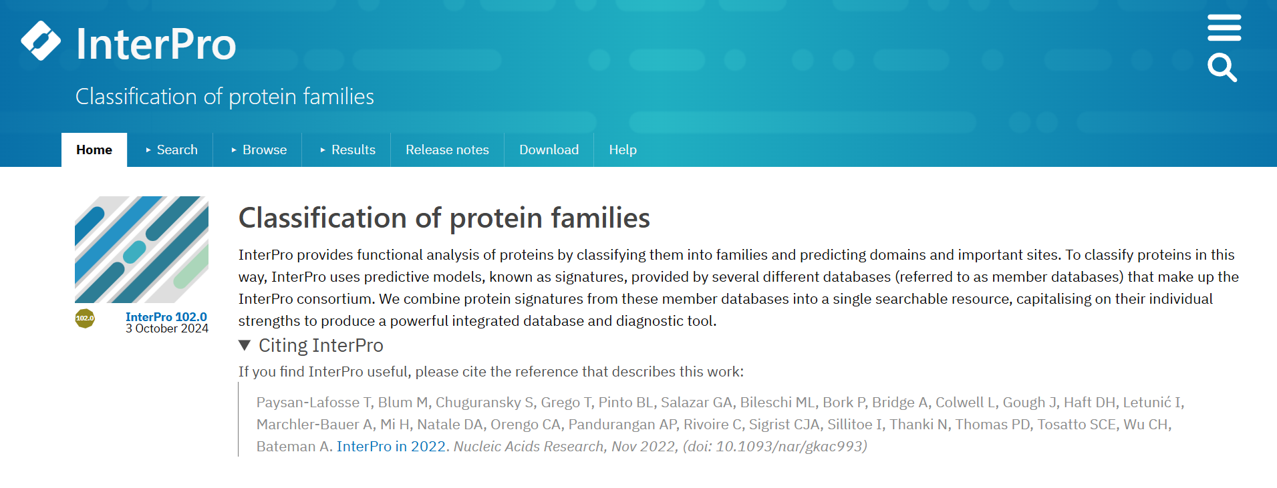
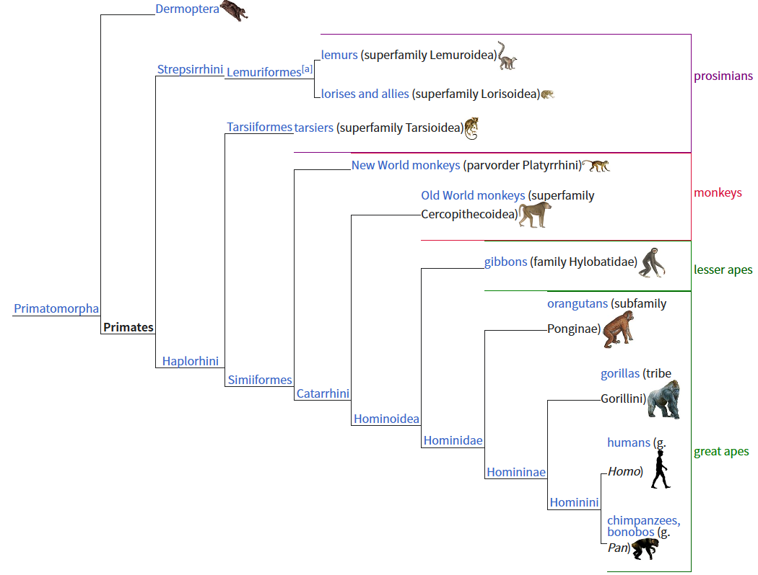
Dataset Construction
The instruction dataset is utilized in the second training stage to enable ProLLaMA to perform various tasks. We first obtain the protein2ipr database from InterPro [37], which includes all proteins from UniProtKB along with their corresponding InterPro annotation information. Subsequently, we iterate through each protein’s rep_id in UniRef50 to retrieve the corresponding annotation information from protein2ipr. This retrieval process is implemented using a distributed Redis database, and only proteins with lengths less than 256 participate in the retrieval to enhance efficiency. We utilize regular expressions to filter out superfamily annotation from the whole annotation. In the end, we obtain 6,350,106 data instances, each of which contains one protein sequence and its superfamily annotation. And the number of unique superfamily annotations is 11,268.
A protein superfamily is the largest grouping (clade) of proteins for which common ancestry can be inferred

Slide 16
Dataset Construction
Then, we process the obtained data into a multi-task instruction dataset following the Alpaca format [38], where each instance comprises three parts: instruction, input, and output. The instruction specifies the task type. We design two tasks: generating proteins based on superfamily and determining the superfamily of the given protein. For the former task, the input is the superfamily annotation, and the output is the expected protein. The latter task is the opposite. We selected these two tasks because they represent PLG and PLU, respectively. Additionally, modeling the relationships between sequences and superfamilies is crucial for uncovering protein functions and evolutionary insights [39]. In the end, the instruction dataset comprises 12,700,212 (6,350,106 * 2) instances, with 90% for training and the rest reserved for testing.
Generate proteins based on superfamily
Determine superfamily of the given protein

Slide 17
Protein Vocabulary Pruning
It is known that LLMs are equipped with large vocabularies in tokenizers, which is beneficial to cover multi-lingual corpora and shorten the length of the input token sequence. However, a larger vocabulary also implies slower tokenization of raw text, along with increased parameters in the model’s Embed layer and Head layer, as discussed in detail in Appendix A.9. When considering only the protein language, such large vocabularies are clearly unnecessary. Therefore, we propose a method called Protein Vocabulary Pruning (PVP). PVP helps ProLLaMA achieve almost the same performance with higher training efficiency, whose proof is in Appendix A.3.
PVP is rule-based. Specifically, we iterate through each token in the original vocabulary and retain it if it meets our predefined grammatical rules (e.g., consisting only of the 20 uppercase English letters representing standard amino acids). We save these tokens and their indices. Using the saved tokens, we construct a smaller vocabulary. We then use the indices to extract the corresponding vectors from Embed and Head layers to construct smaller ones. Thus, we can train LLMs using reduced vocabulary and parameters.

Slide 18
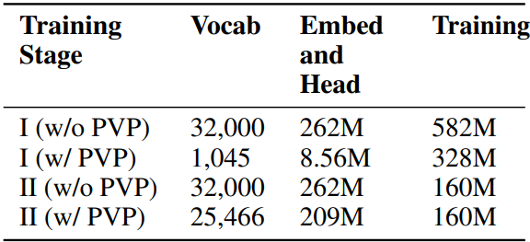
Protein Vocabulary Pruning
PVP is employed before training. After training, the vocabulary can be recovered back to its original size by incorporating the entries from the original vocabulary. This process is also applicable to the Embed and Head layers, restoring them to their original dimensions. This ensures that the architecture of LLMs remains entirely consistent both before and after training, facilitating potential training on broader corpora in the future. Naturally, if subsequent training is not a consideration, omitting the recovery operation is permissible.
We use PVP in both the first and second training stages of ProLLaMA, and its effects are shown in Table 1. It is evident that we achieve a significant compression rate in the first stage, primarily because the dataset in the first stage contains only protein sequences, which can be summarized by a simple rule. In contrast, the dataset in the second stage also includes English. More details about PVP is shown in Appendix A.3.
Table 1: Effects of PVP. The vocabulary size, parameter numbers in Embed and Head layers, parameter numbers involved in training are listed.

Slide 19
Learning Protein Language
As mentioned in Section 1, current PLMs lack natural language abilities, which hinders multi-task capabilities. To solve this problem, we propose leveraging LLaMA2 to perform continued pre-training on protein language. This approach is analogous to humans learning a foreign language, where the model learns protein language w
We add Low-Rank Adapters (LoRA) into LLaMA2. To be specific, in each decoder block, we add LoRA to certain weights including Wq, Wk, Wv, Wo, Wup, Wgate and Wdown. The original parameters are frozen, enabling only LoRA to be trained. Due to the significant differences between protein language and natural language, we choose a relatively high rank for LoRA, which helps the model learn protein sequences better and prevents under-fitting. We also include both the Embed and Head layers in training. This is based on the premise that a token may have different meanings in protein sequences and natural languages, requiring distinct embeddings for the same tokenhile retaining its original natural language abilities.

Slide 20
Learning Protein Language
We trained the model using causal language modeling on the protein language dataset, resulting in ProLLaMA. Details on causal language modeling are provided in Appendix A.1. Benefiting from PVP and LoRA, as shown in Table 7, we train only about 5% of the parameters, in contrast to full-parameter training, which significantly reduces training costs. Additionally, as the remaining parameters are not involved in training, the inherent natural language abilities are preserved.
In summary, we have developed ProLLaMA, a model that comprehends both protein language and natural language, with reduced training costs. Consequently, we have addressed two problems mentioned in Section 1: the lack of natural language abilities and excessive training costs.

Slide 21
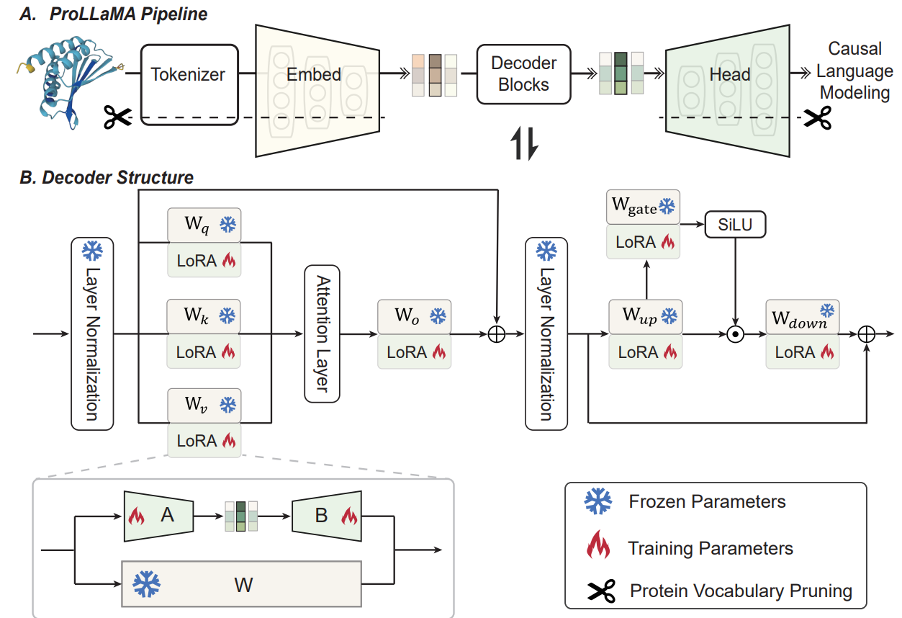
Learning Protein Language
Figure 3: The overview of the ProLLaMA model. We add low-rank adapters (LoRA) to certain weights and apply protein vocabulary pruning (PVP). We freeze original parameters, focusing solely on training LoRA (Embed and Head are also involved in the first training stage).

Slide 22


Performing Multiple Tasks
As aforementioned, current PLMs are unable to perform multiple tasks based on user instructions. To solve this problem, we perform instruction tuning on ProLLaMA obtained from the previous section.
We train ProLLaMA on the instruction dataset mentioned in Section 3.1:
Here, Θ denotes the parameters to be optimized, L the loss function, and D the dataset. u denotes the instruction and the input of one instance. For brevity, when we refer to the instruction in the following text, it includes the input as well. x = {x0, x1, . . . , xn−1} denotes the output, where xi is the i-th token of the output.
Since causal language modeling is employed, we need to combine Equation 1 with Equation 3:
Notes:
Authors use the Negative Log Likelihood loss
Loss is averaged over all input-output pairs(u,x)

Slide 23

Performing Multiple Tasks
Equation 2 is the optimization objective for instruction tuning of ProLLaMA. u is not involved in the loss calculation, whereas x is. This is because the latter is the output part, where ensuring its quality of generation is crucial. The former, u, only needs to be understood by the model. In the instruction tuning stage, we exclusively train LoRA at a lower rank than specified in Section 3.3.
In summary, through instruction tuning, we have made ProLLaMA capable of following instructions and performing multiple tasks. Consequently, we have addressed the problems mentioned in Section 1: the lack of instruction following and the lack of multi-task capabilities.
In addition, the tasks that ProLLaMA can perform depend on the tasks included in the instruction dataset. Appendix A.7 shows that by training on an additional instruction dataset, ProLLaMA also performs well in predicting protein solubility.

Slide 24
Experiments
We introduce the experiment setup in Section 4.1. And we evaluate the unconditional protein generation task in Section 4.2, the controllable protein generation task in Section 4.3, the protein property prediction task in Section 4.4.

Slide 25
Experiment Setup
Training Settings: For continued pre-training, the LoRA rank is set to 128, employing the AdamW optimizer alongside a cosine annealing scheduler with warm-up. The peak learning rate stands at 5e-5, with a total of one training epoch. It takes six days on eight A6000 GPUs using FlashAttention-2 [41]. For instruction tuning, the LoRA rank is set to 64 with two training epochs, and all other settings remain consistent with the continued pre-training setup. It takes 5 days on eight A6000 GPUs. More training details can be found in Appendix A.4.
Evaluation Settings: Unconditional protein generation involves generating protein sequences without specific instructions. Controllable protein generation involves generating desired protein sequences based on instructions that specify the required superfamily. Property prediction involves predicting protein superfamily based on instructions, which include the protein sequences to be predicted. All evaluations are conducted on one GPU with 24GB of VRAM, with model inference occupying approximately 13GB of VRAM.
Evaluation Metrics: We use the following metrics to evaluate the generated protein sequences. The pLDDT [42] is used to measure whether sequences are structurally plausible. Self-Consistency Perplexity (SC-Perp) [40] serves as an additional metric of plausible structures since pLDDT falls short in dealing with intrinsically disordered regions (IDRs) [43]. TM-score [44] reflects the structural similarity between generated sequences and known ones in AFDB [45] and PDB [46]. RMSD also reflects the structural similarity from the perspective of atomic distance. Homologous probability (HProb) reflects the probability that the generated protein is homologous to a known one. Seq-Ident reflects the sequence similarity between generated sequences and known ones. More details are shown in Appendix A.5.

Slide 26
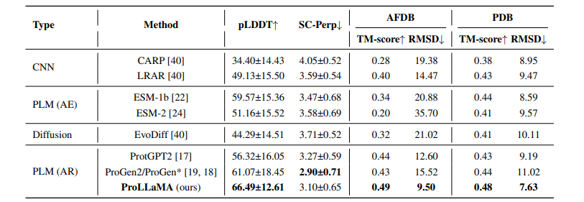
Unconditional Protein Generation
We compare our model with other models in protein sequence generation. These models cover a variety of types, with parameter numbers shown in Table 7. Table 2 shows the results. Our ProLLaMA is optimal on pLDDT, TM-score, and RMSD and is suboptimal on SC-Perp. This indicates that ProLLaMA, through its training on protein sequence data, can generate structurally plausible proteins. Notably, ProLLaMA-generated proteins exhibit a mean and standard deviation for pLDDT and SC-Perp of 66.49±12.61 and 3.10±0.65, respectively. These values are comparable to those of natural proteins as reported in [40], which are 68.25±17.85 and 3.09±0.63, respectively. It is noted that we list ProGen2 and ProGen as the same item in the table, referring to Appendix A.6 for explanation.

Slide 27
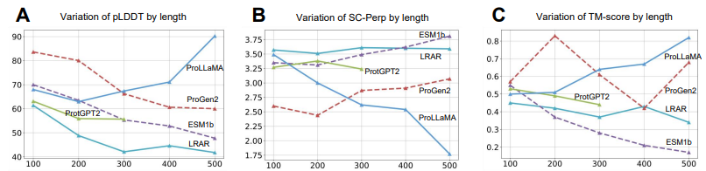
Unconditional Protein Generation
De novo design of long and structurally plausible protein sequences is highly challenging [17], yet our ProLLaMA performs well. As shown in Figure 4(A)(B)(C), when the length is more than 300, ProLLaMA performs the best in all the three metrics. Although ProGen2’s performance is better in short sequences (length≤200), it decreases as the length increases. This indicates that ProLLaMA is able to capture long-range dependencies between amino acids while other model's struggle.

Slide 28
Controllable Protein Generation
We utilize four superfamily descriptions as instructions respectively: the S-adenosyl-L-methioninedependent methyltransferase superfamily (SAM-MT), the Tetratricopeptide-like helical domain superfamily (TPHD), the Thioredoxin-like superfamily (Trx), and the CheY-like superfamily (CheY). For each superfamily, ProLLaMA generates 100 protein sequences. We randomly select 100 natural proteins from each of the four superfamilies as benchmarks for comparison. We employ Foldseek[47] to compare generated proteins with natural ones.
The results shown in Table 3 demonstrate that ProLLaMA can generate desired protein sequences based on instructions that specify the required functionalities, confirming the capability for controllable generation. For SAM-MT, the TM-scores of our generated sequences exceed 0.7; for TPHD and CheY, they are over 0.8; and for Trx, they surpass 0.9. The high TM-score indicates that the structures of the generated proteins closely resemble those of natural proteins in the same superfamily, implying functional similarity. For SAM-MT, TPHD, Trx, and CheY, all of the H-prob values are close to or even equal to 100%, indicating that the generated proteins are homologous to natural proteins and belong to the same superfamily. In summary, these provide strong evidence that the protein generation of ProLLaMA is controllable under instructions. In contrast, other models exhibit low TM-score and very low H-Prob due to their uncontrollable generation

Slide 29
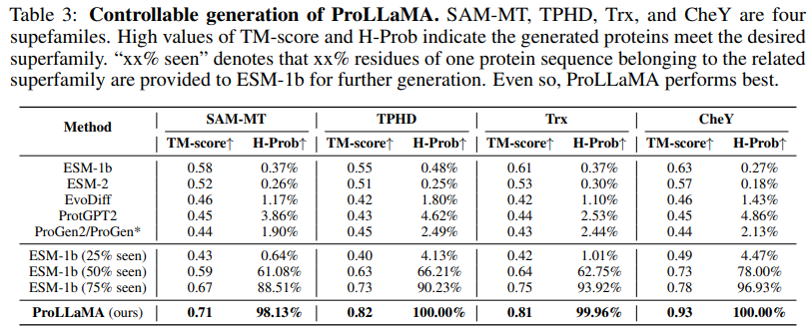
Controllable Protein Generation

Slide 30
Controllable Protein Generation
We also conduct another experiment. We provide residues of natural proteins belonging to the superfamily to ESM-1b, allowing ESM-1b to complete these sequences, rather than generating them from scratch as done previously. As seen in Table 3, with more residues provided, the proteins generated by ESM-1b increasingly exhibit the characteristics of the corresponding superfamily. Even so, it still does not surpass ProLLaMA. Higher TM-score and H-prob indicate that, under instruction control, ProLLaMA’s de novo protein generation even outperforms the non-de novo generation by ESM-1b, which is provided with 75% of the residues. These results indicate that ProLLaMA can effectively capture structural and evolutionary relationships (as reflected by TM-score and H-prob) solely through learning from text and sequences.
Additionally, using natural proteins as a benchmark, we assess pLDDT, SC-Perp, and TM-score of proteins generated by ProLLaMA. Figure 4(D) shows that for CheY, TPHD, Trx, and SAM-MT, the average pLDDT of generated proteins is only 19.0%, 1.41%, 10.9%, and 10.3% lower than that of natural proteins, respectively. Figure 4(E) shows that for TPHD and SAM-MT, the average SC-Perp is 5.66% and 5.06% lower; for Trx and CheY, the average SC-Perp is 7.58% and 14.92% higher. Figure 4(F) visualizes the TM-score, with scores near the maximum indicating a high degree of structural similarity. These findings indicate that proteins generated by ProLLaMA are roughly comparable to their natural counterparts in the same superfamily.

Slide 31
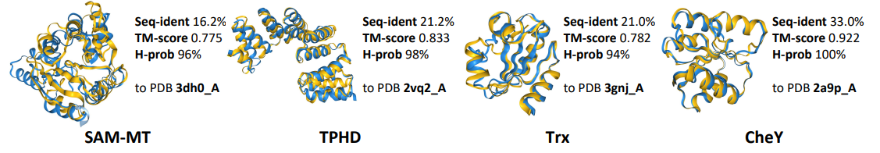
Controllable Protein Generation
Figure 5: Protein visualization. Four proteins of controllable generation by ProLLaMA using SAM-MT, TPHD, Trx, and CheY as instructions. Blue is generated proteins, and yellow is natural. They are similar in structure but different in sequence.
In Figure 5, we visualize four examples of proteins generated by ProLLaMA (colored in blue) alongside the most structurally similar natural proteins from PDB (colored in yellow). The significant overlap in 3D structures and the high TM-score confirm structural similarity. Low Seq-ident indicates sequence diversity. In summary, through controllable protein generation, ProLLaMA is capable of generating desired proteins with structures similar to natural proteins, yet with novel sequences.

Slide 32
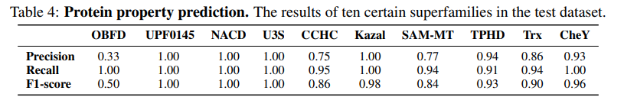
Property Prediction
We use the test dataset to evaluate whether ProLLaMA can predict the superfamily to which a given protein belongs. The test dataset consists of 10,000 samples. Although ProLLaMA performs a classification task here, it is more complex than typical ones. The key difference is that typical classification tasks require models to output a fixed label, often in one-hot encoding. In contrast, ProLLaMA outputs the text. The advantage of the latter lies in its flexibility, such as the ability to easily handle situations where a sample belongs to multiple categories simultaneously. However, this increases task difficulty due to the much larger number of potential classification categories.
Even so, as shown in Table 5, ProLLaMA generates superfamily descriptions that exactly match the real descriptions in 62% of the test dataset. In addition, Table 4 illustrates ProLLaMA’s performance on ten specific superfamilies. The recall value exceeds 0.9 in all the ten superfamilies and the F1-score exceeds 0.8 in nine superfamilies. The calculation formulas for these metrics can be found in Appendix A.5. Additional experiments on protein solubility prediction using ProLLaMA can be found in Appendix A.7.

Slide 33
Related Work
Protein Language Models. Recognizing the similarity between natural language sequences and protein sequences, many methods from NLP have been applied to protein sequence data [48–51]. This has led to the development of PLMs, which are broadly categorized into two types [12, 52]: AutoRegressive (AR) PLMs and Auto-Encoder (AE) PLMs. AR PLMs adopt the decoder-only architecture and Causal Language Modeling (CLM) [53, 54]. They primarily concentrate on PLG [55, 17–19], with a minority also focusing on fitness prediction [10]. AE PLMs adopt the encoder-only architecture and Masked Language Modeling (MLM) [20–24]. They excel in PLU, with the learned protein representations being applied to downstream predictive tasks [29]. However, they face challenges in de novo protein generation. Our ProLLaMA is capable of multitasking, excelling in tasks that both of the above types specialize in, surpassing existing PLMs. This multitasking capability is achieved through instruction following, making it user-friendly. We have also noticed the recent emergence of scientific LLMs [13, 14, 56–58]. In Appendix A.10, we discuss the differences between these models and ProLLaMA.

Slide 34
Related Work
Training LLMs. There is a general training framework for LLMs [4], where LLMs are first pretrained on large-scale corpora [59] and then undergo instruction tuning to follow user instructions [60]. However, we believe that our proposed two-stage training framework differs in motivation and insights, as discussed in Appendix A.11. Considering the vast number of parameters in LLMs, various parameter-efficient techniques have been proposed to accelerate training and conserve memory [61, 62, 35, 63, 64], including LoRA. For the same reason, some vocabulary pruning methods have been studied [65], which rely on statistics specific to a provided dataset. This results in them being more time-consuming and failing to leverage the prior patterns of the dataset. In contrast, our PVP, derived from the prior data patterns, achieves excellent compression rates.

Slide 35
Conclusion
Existing PLMs excel in either protein generation tasks or protein understanding tasks. In this work, we introduce an efficient training framework to transform any general LLM into a multi-task PLM. We construct an instruction dataset containing both generation tasks and understanding tasks. We propose PVP to improve training efficiency. We develop ProLLaMA, a versatile PLM for multiple tasks like controllable protein generation and protein property prediction. Experiments indicate that ProLLaMA performs exceptionally well. We are confident that our work will have a significant impact on the AI4Science community.

Slide 36
Questions?

